Slide 1


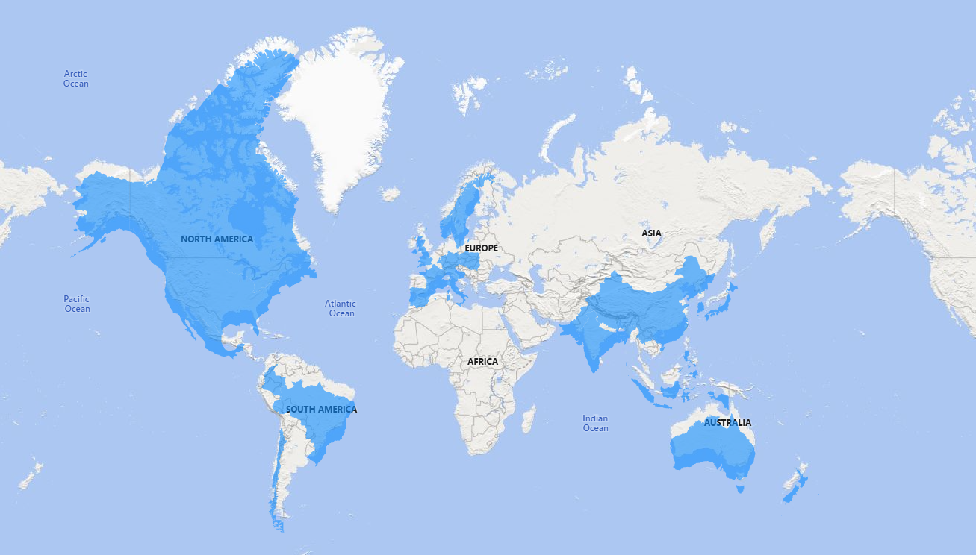
AtliQ Hardware’s Business Insights
Consumer Goods Electronic Company
Growing Rapidly and Operates Across Various Regions and Countries

Slide 2

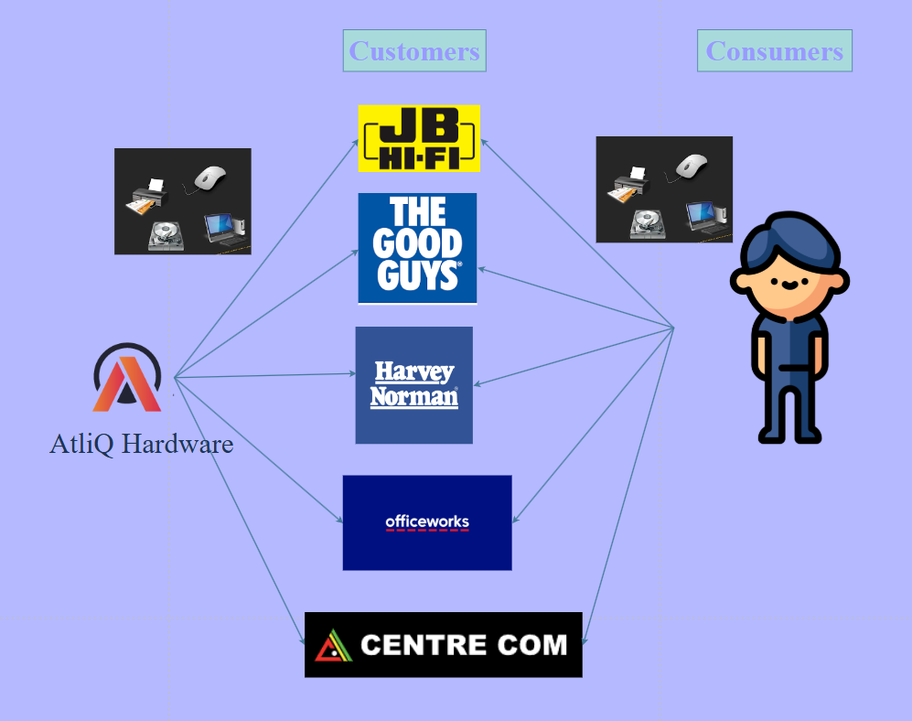
AtliQ Hardware’s Business Model
AtliQ manufactures hardware and sells them to customers(Stores)…
The Store then sells it to end consumers.

Slide 3
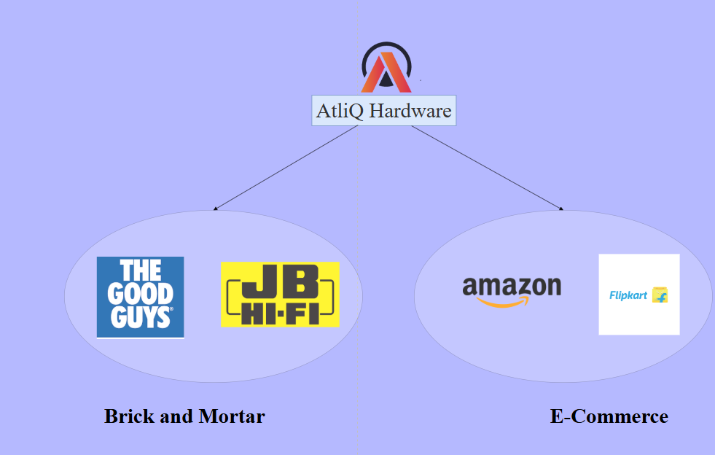
AtliQ Hardware’s Platforms
Brick & Mortar (Physical Stores)
E-Commerce (Ecommerce Stores)

Slide 4
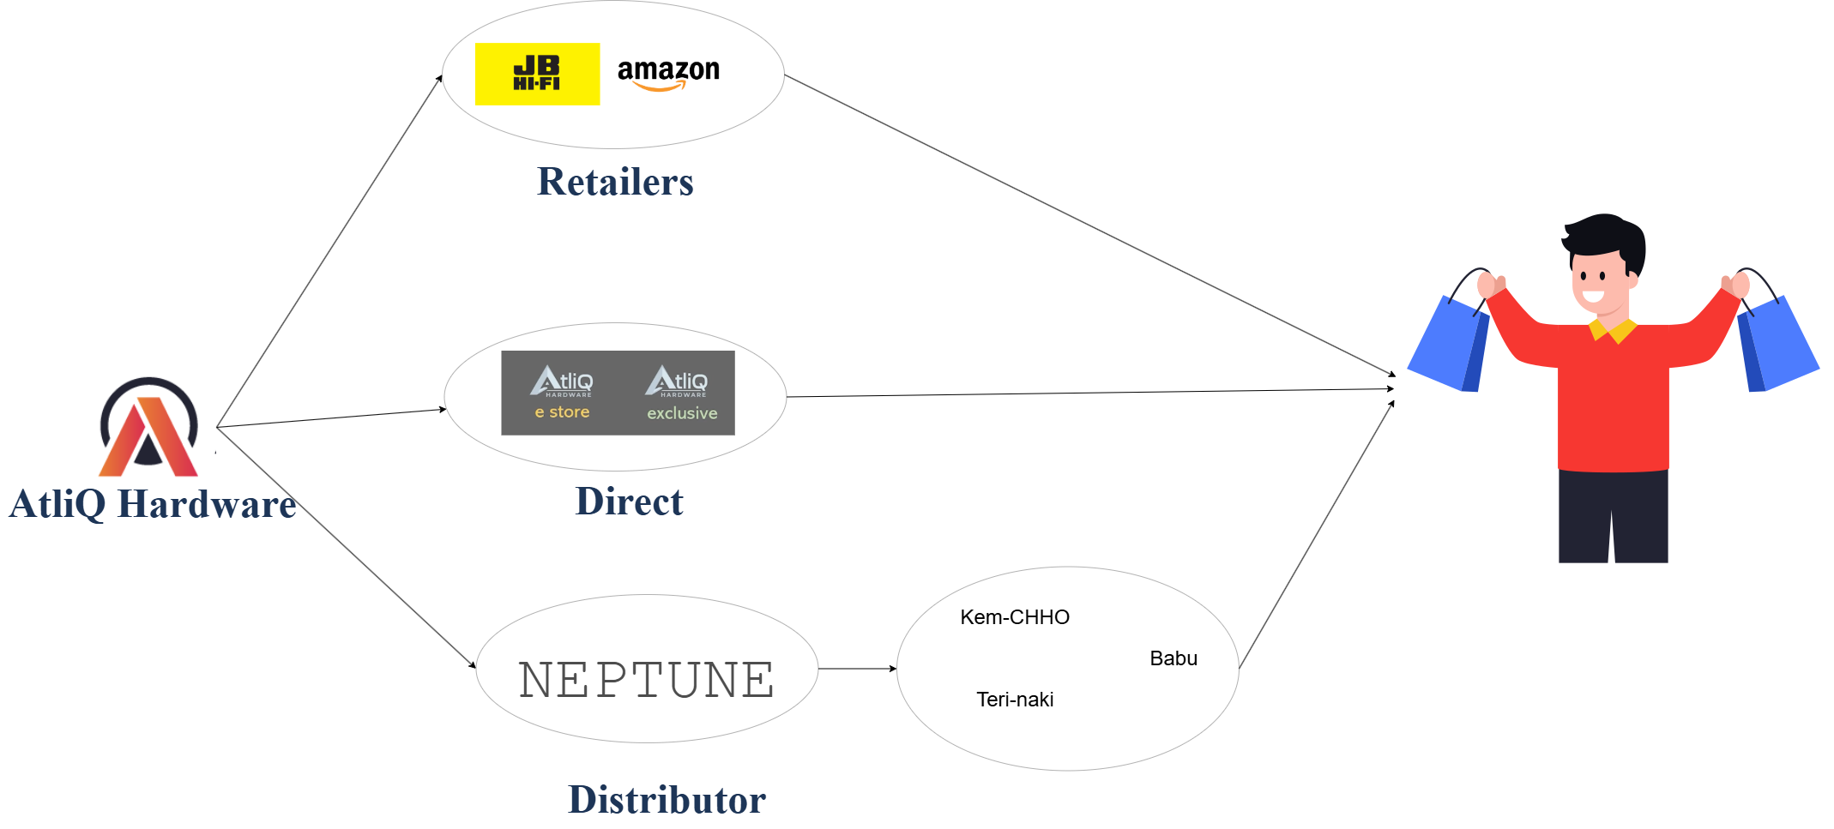
AtliQ Hardware Channels
Retailers
Direct
Distributors

Slide 5

AtliQ Hardware’s Problem Statement
While they grew exponentially in a matter of few years….
Bitter experience in Latin America
Established their presence only with few surveys and intuition
Used Excel files to make decisions
Facing competitions from other big players like Dale , BP, Pacer
Solution:
Onboard Data Analysts
Make Data Driven Decision

